Slide 1
CSC 595 Project Ideas
By Dhaval Joshi

Slide 2
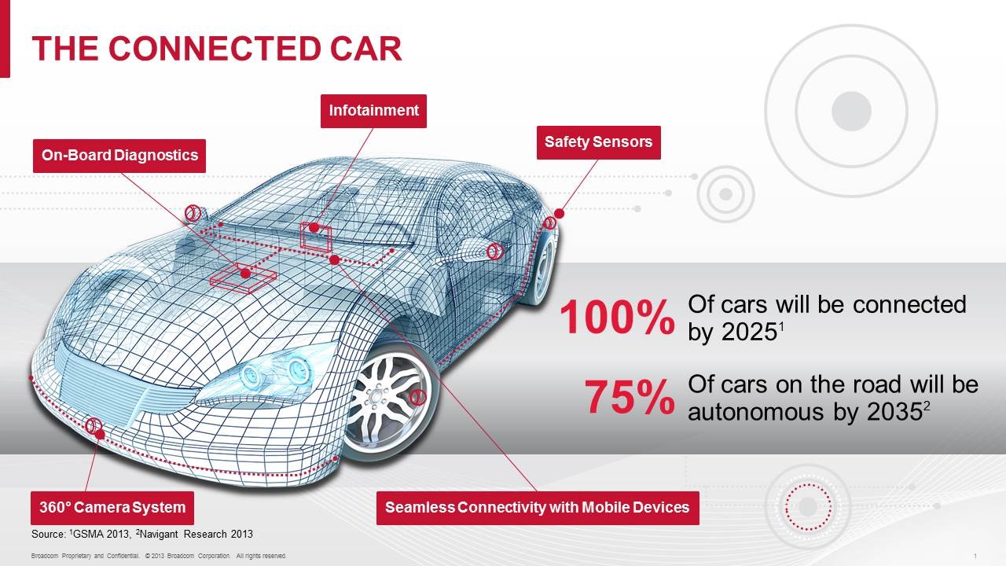
Concept: Connected Car

Slide 3
Concept: Connected Car
Voice Assistance via car audio
Driving Tips(Based on weather, driving data, etc)
Maintenance reminders and updates (notifications from friends and family)
Status Update (E.g. Engine status, Fuel status, Tyre pressure, etc)

Slide 4
Requirements
Internet Connectivity
Locations Awareness
OBD 2 Port Connectivity
Allstate SDKs

Slide 5
Thank you!

